Slide 1
Heart Disease Prediction
Ultron’s
K.Naveen Kumar
T.Dileep

Slide 2
Introduction
Technologies Used : - Machine Learning by using Python Programming Language , Regression Model based on Decision Tree
What is Machine Learning : - ML is a Sub part of AI and it uses algorithms to know what type of work it was doing & collects data, then learns from that data and makes decisions based on what it have learned
What is Python : - Python is a high level programming language & also a scripting language which is open source and runs across cross platform. and used for Web Applications, GUI, Machine Learning, Data Analysis, Scientific Calculations and many more...
What We Need : - IBM Cloud With NODE RED
Dataset Used : - H one Dataset

Slide 3
In this World, 3 out of 10 people suffers from Cardiovascular Diseases
For this we we’re Taking Some Random Dummies to Explain

Slide 4
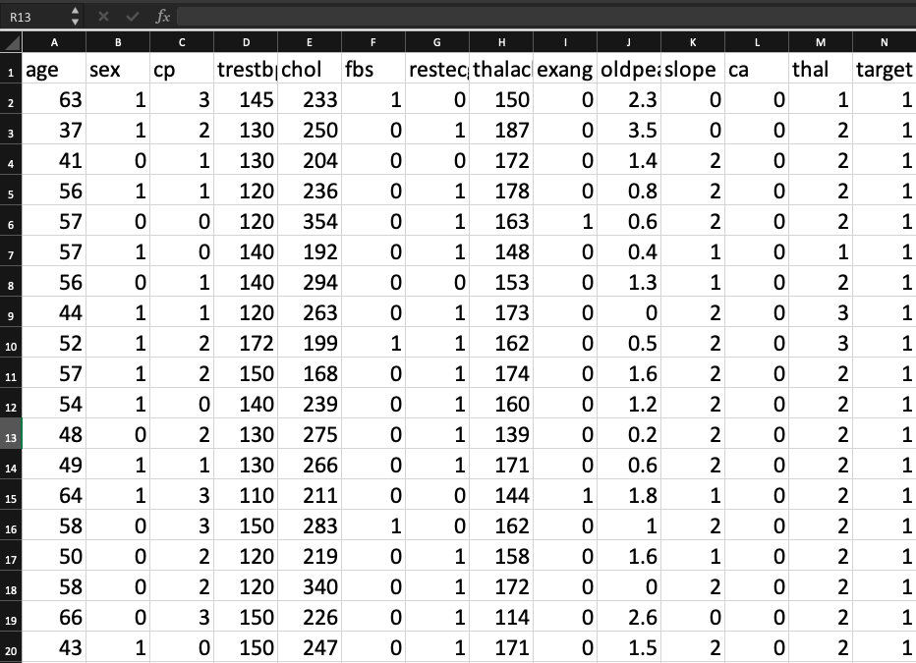
Model Explanation :-
Here we used Regression Model.
We’ve taken this model to classify whether that particular person will be affected with cardiovascular disease or not and we got the accuracy
Dataset :- in this dataset we taken the particulars of the elements which are most use full for the patients health

Slide 5
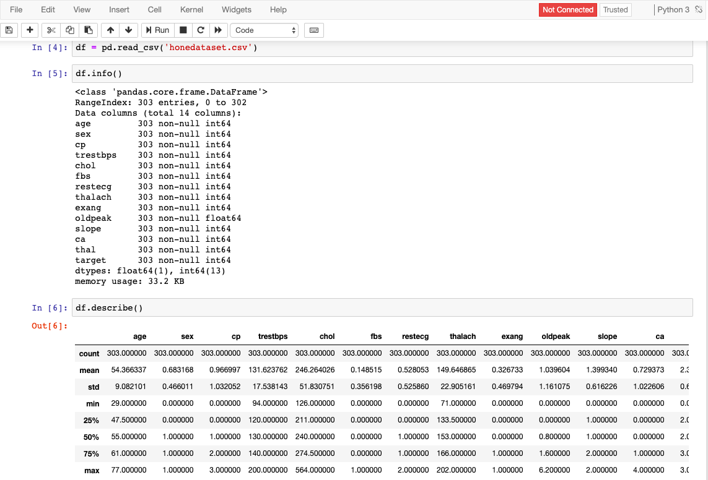
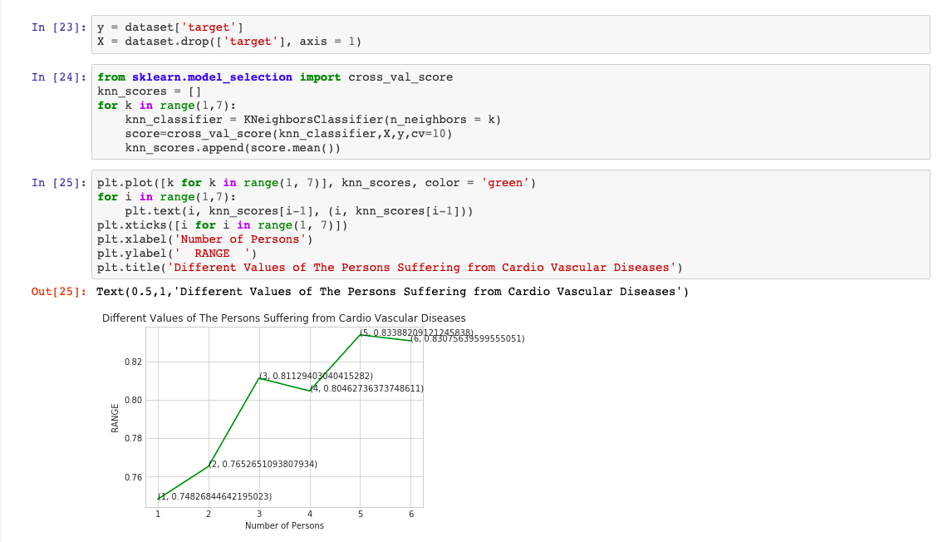
Program We Used

Slide 6
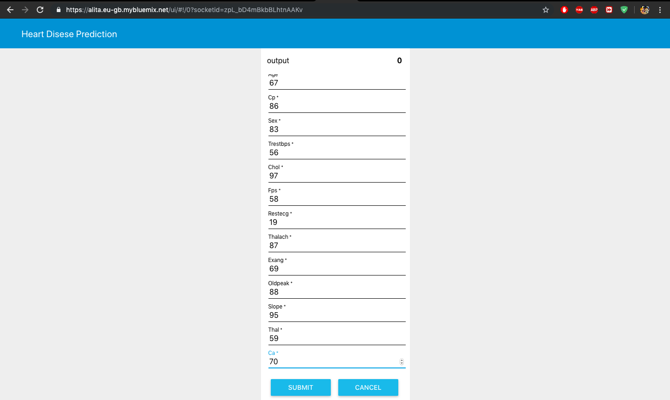
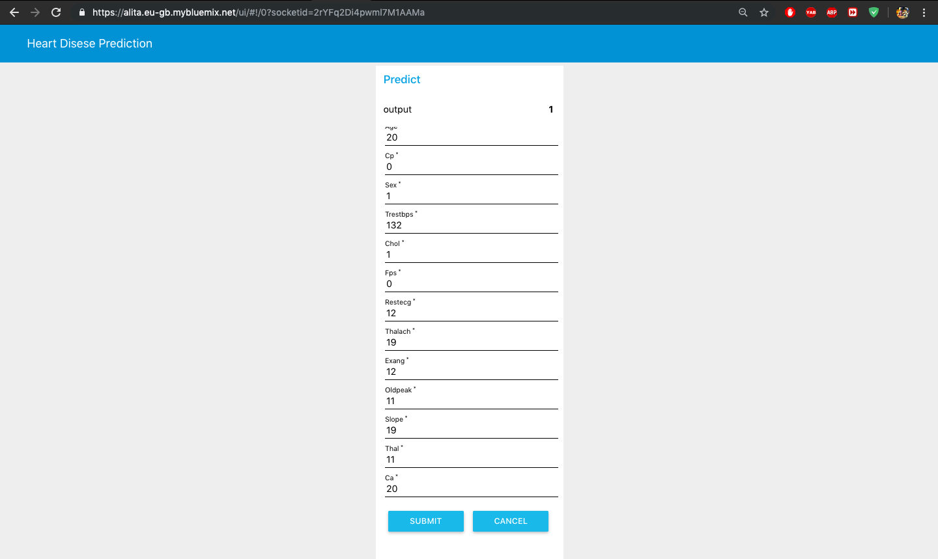
Graphical User Interface

Slide 7
Advantages & Disadvantages
Easily extended to multiple classes
Quick to train
Good Accuracy for many simple data sets
Very fast at classifying unknown records
Resistant to overfitting
it is limited to the linear relationship
it is easily affected by outlier

Slide 8
Conclusion
Hence We Used The Machine Learning Techniques and Predicted whether the particular person is Suffering from Cardiovascular Disease or not……...

Slide 9
Thank You

